Slide 1
DISASTER MANAGEMENT & RELIEF
WE ARE ONE...!!!!
Submitted By-
Ankit Sinha-58
Nikhil Pathak-59
G Sumeet Samuel-60

Slide 2
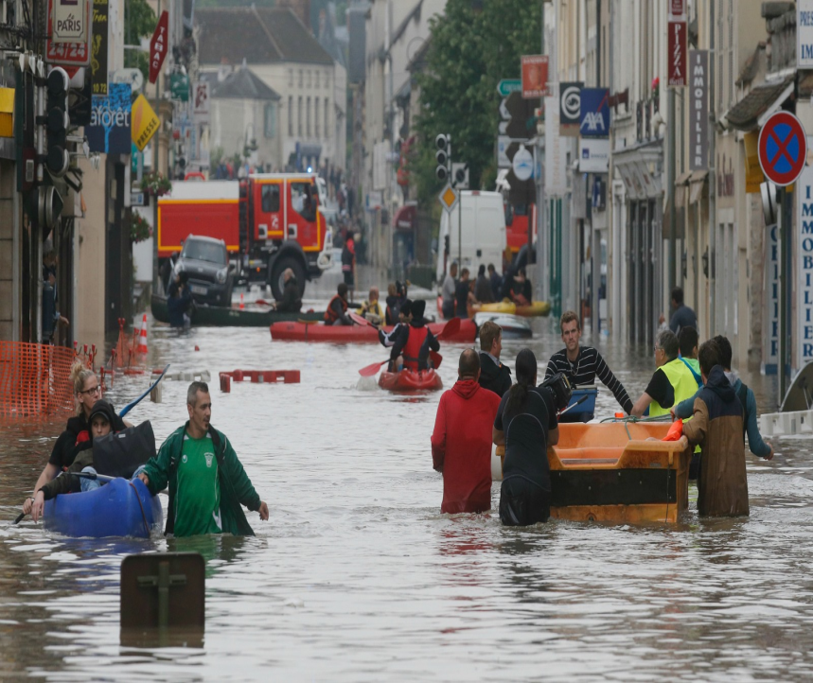
1. INTRODUCTION
A disaster is a serious disruption in the functioning of a community and society as a fall-out of widespread human, material, or environmental losses that exceed the ability of the affected population to cope with its own resources. India is a disaster prone country.

Slide 3
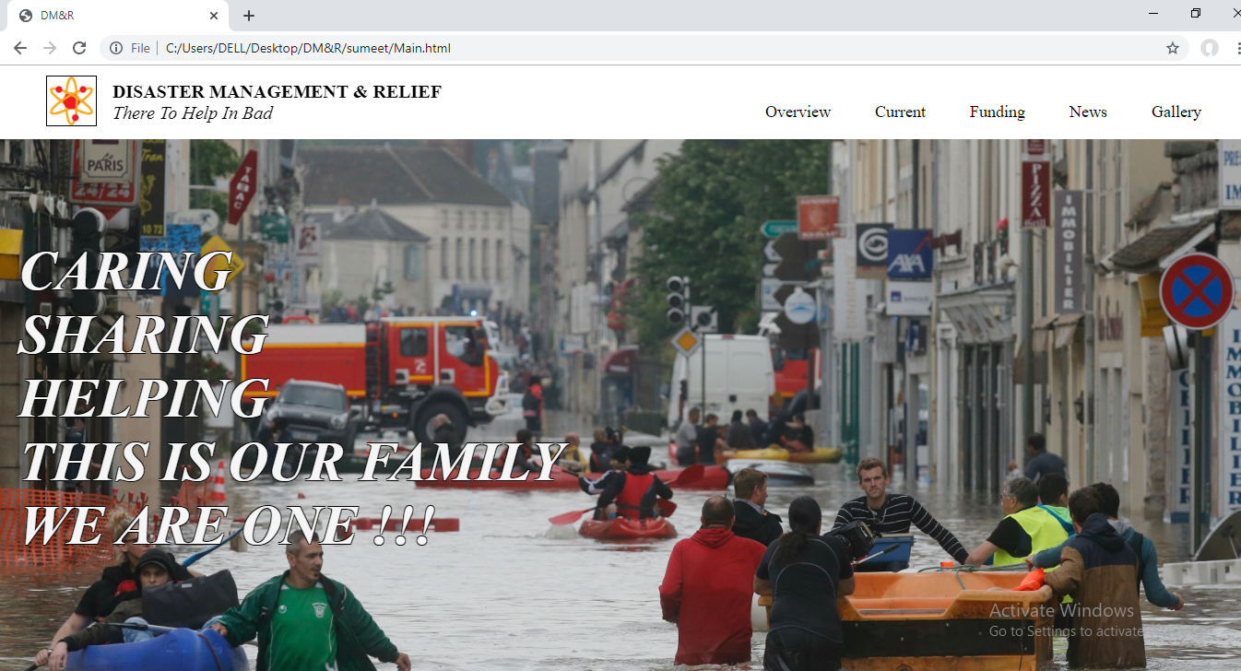
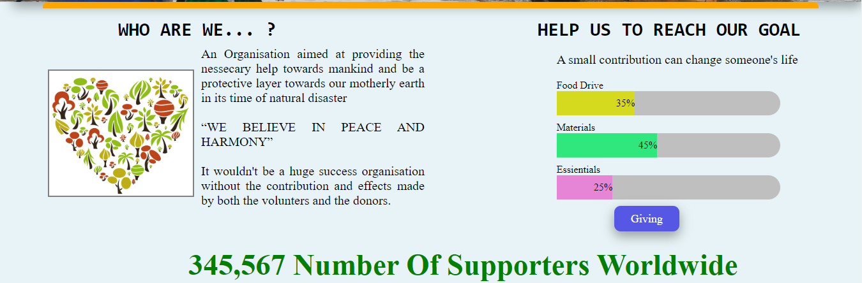
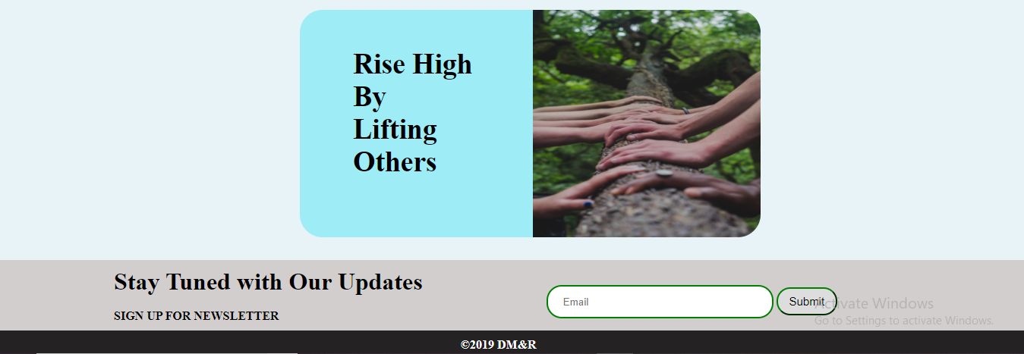
1. MAIN:
HTML5
CSS3
JAVASCRIPT3
JQUERY
BOOTSTRAP

Slide 4
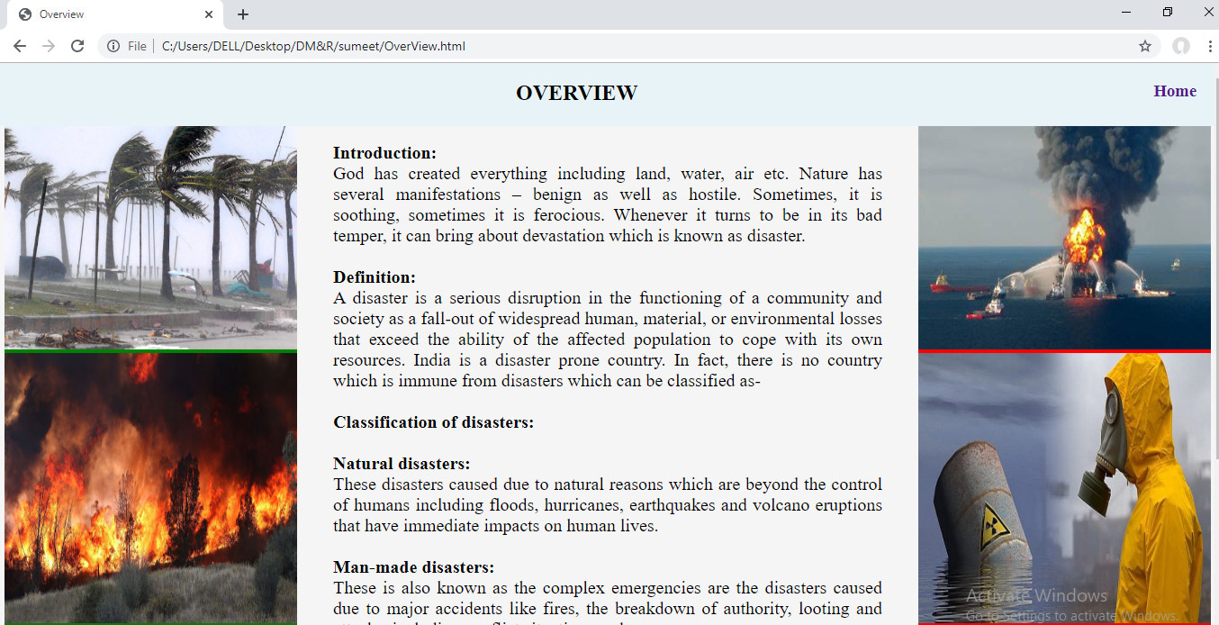
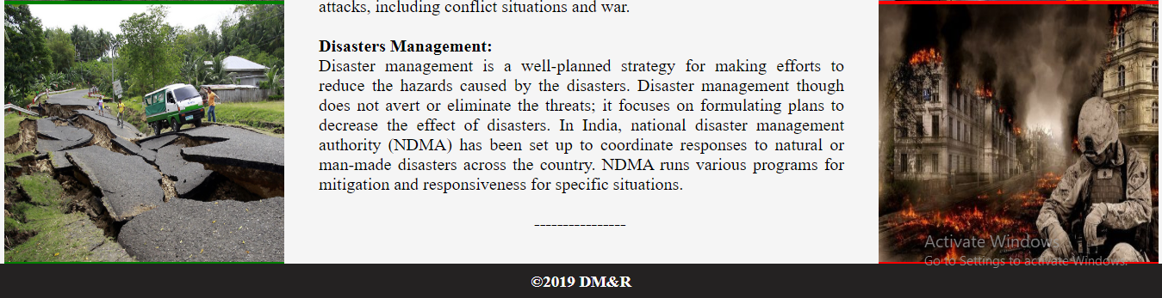
2.OverView:

Slide 5
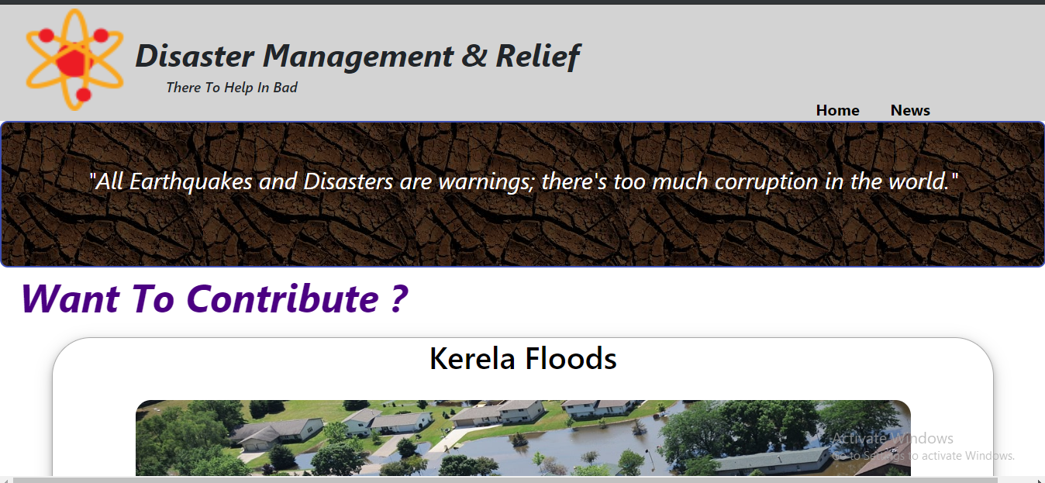
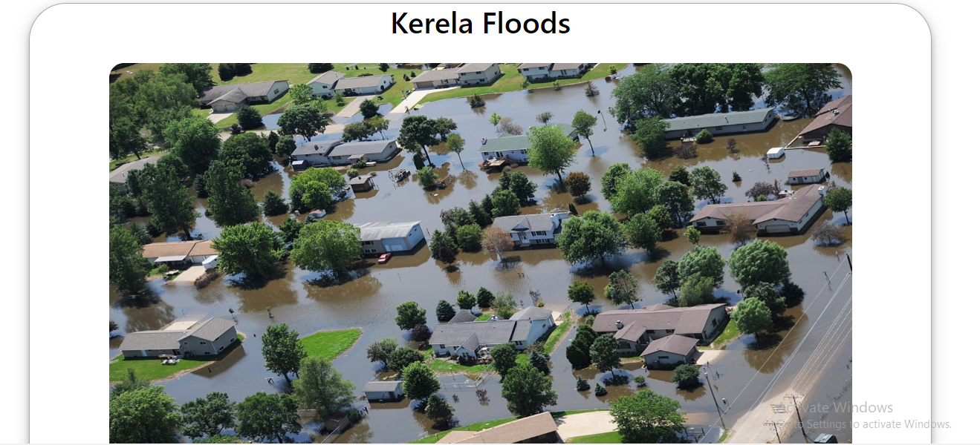
3. Current:
Notes:
5

Slide 6
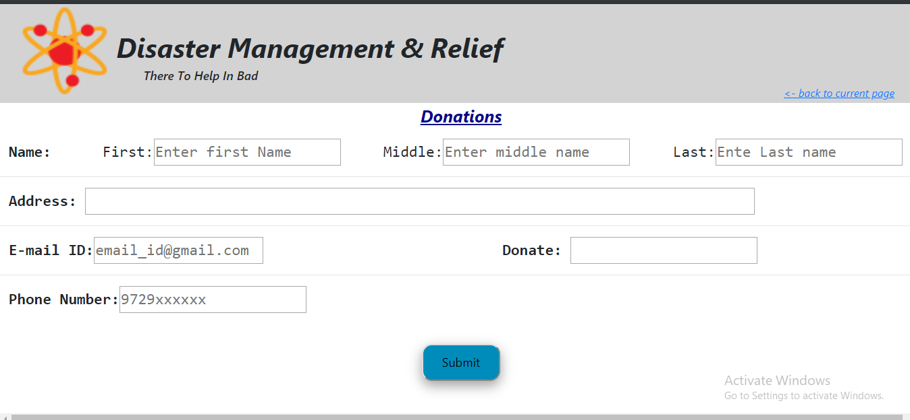
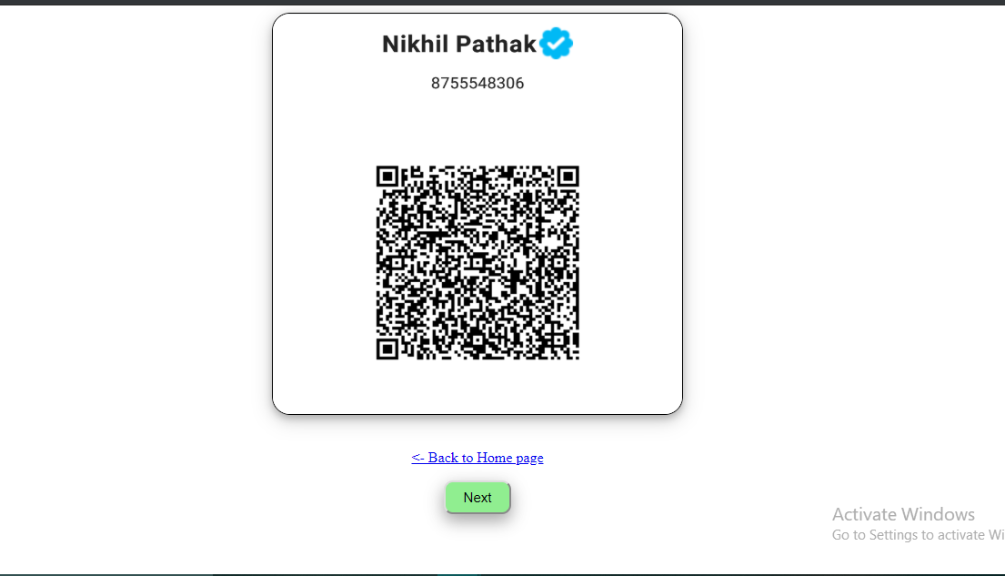
4. Funding:

Slide 7
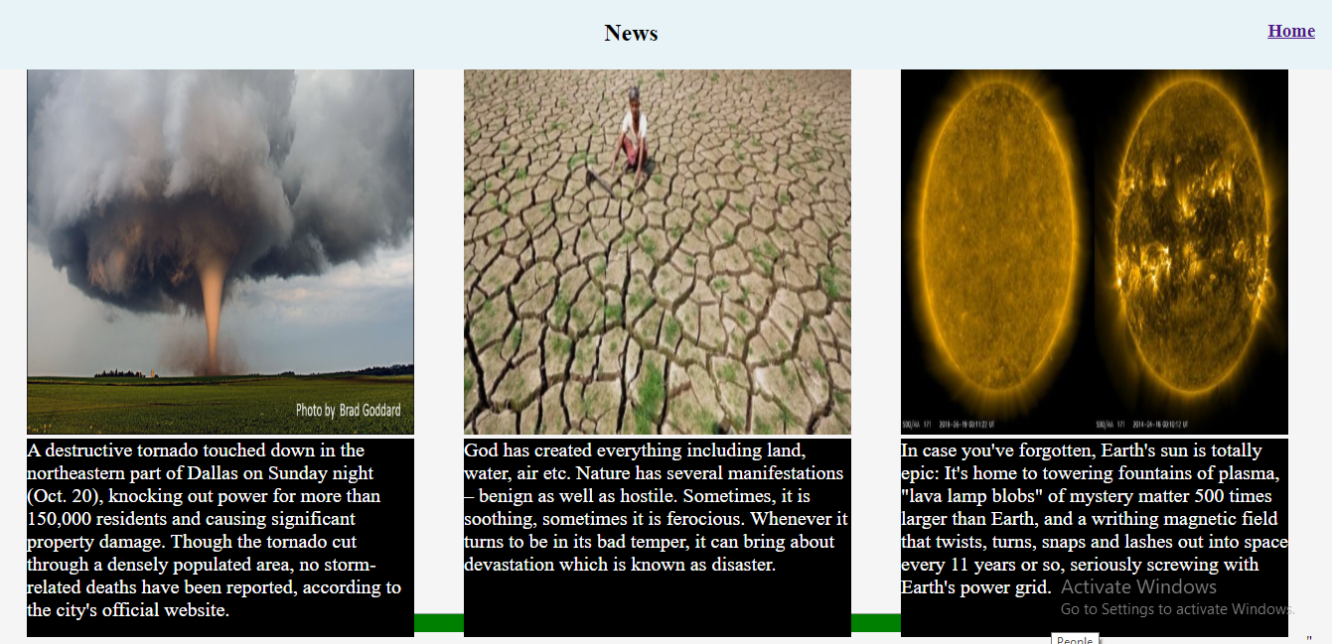

5. NEWS:

Slide 8
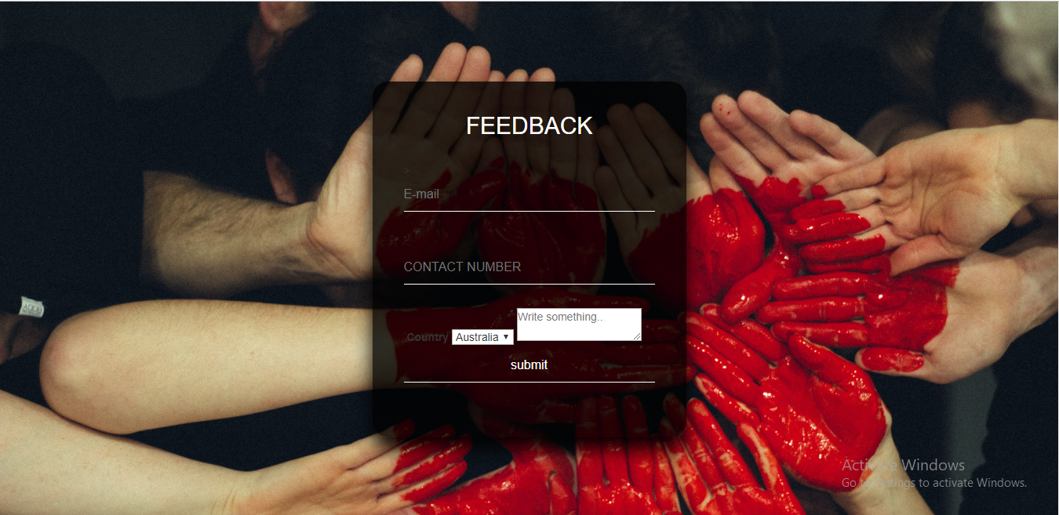
6. FEEDBACK:

Slide 9
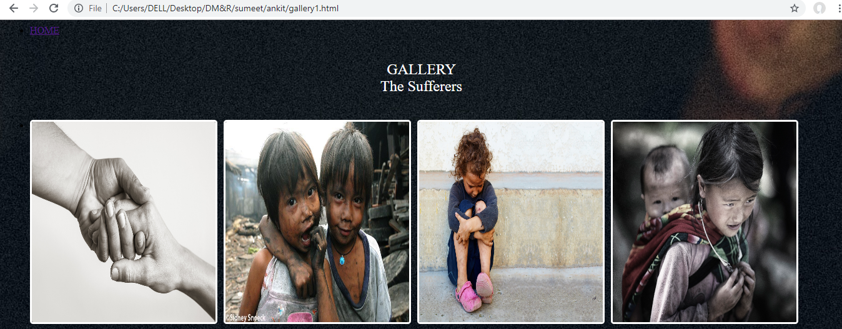
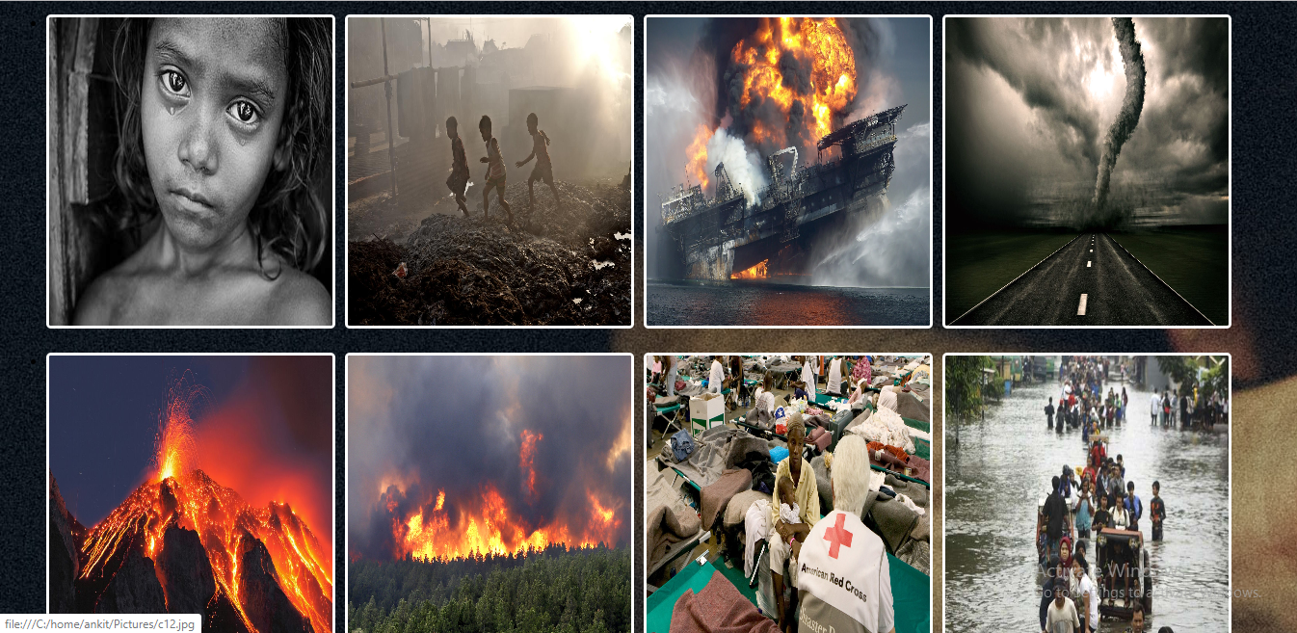
GALLERY

Slide 10
Swot Analysis:
Strengths:
2) Time-Saving.
3) Cost Effective.
4) Direct interaction with user.
Weakness:
Security.
Fake Websites.
Opportunities:
2)Changing trends.
3)High Availability.
Threats:
Innovation.
Risk.

